Slide 1
Destructor & Exception Handling

Slide 2
Destructor
A Destructor function is complementary to a constructor. That is, it is invoked the moment any instance of a class ceases to exit.
Destructor function de-initialize the objects when the are destroyed. A destructor is automatically invoked when an object of a class goes out of scope. Therefore, a programmer relieved of the task of clearing the memory space occupied by a data member every time an object goes out of scope.
Declaration of Destructor:
A destructor function has the same name as its class but prefixed with a ~(tiled). A class have only one Destructor. It cannot specify a return value or explicitly return a value.
Ex:
class Student
{
Int rno,mark;
Public:
………….
~Student()
{
rno=mark=0;
}
}

Slide 3

Destructor Real Time Example Now conclude Shri Ganesha Puja with Visarjan after 7 days or 10 days. This is called Destructor of an object.

Slide 4
Exception Handling
Exception Handling is a feature of C++ that provides a standard facility to deal with runtime exceptions.
Some common exceptions are division by zero, an array overflow or underflow, opening a file in an unknown mode, and de-referencing of the NULL Pointer.
Exception Handling is implemented in c++ using three distinct components try, catch and throw statements.
Ex:
try
{
Int age;
Cout<<“Enter age:”; cin>>age;
If(age>100 || age<1)
throw “invalid age”;
Cout<<“ age accept”;
}
catch(char *msg)
{
Cout<<“Error :” << msg;
}
catch(…)
{
Cout<<“ unknown error “;
}

Slide 5
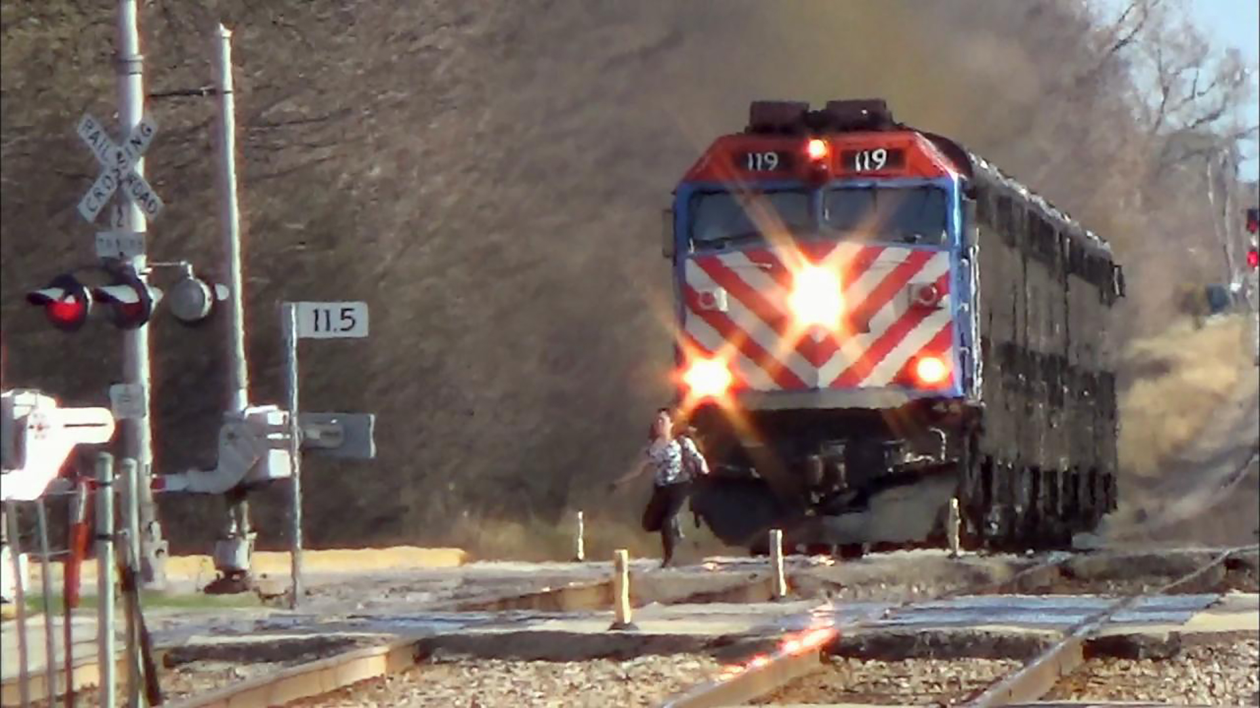
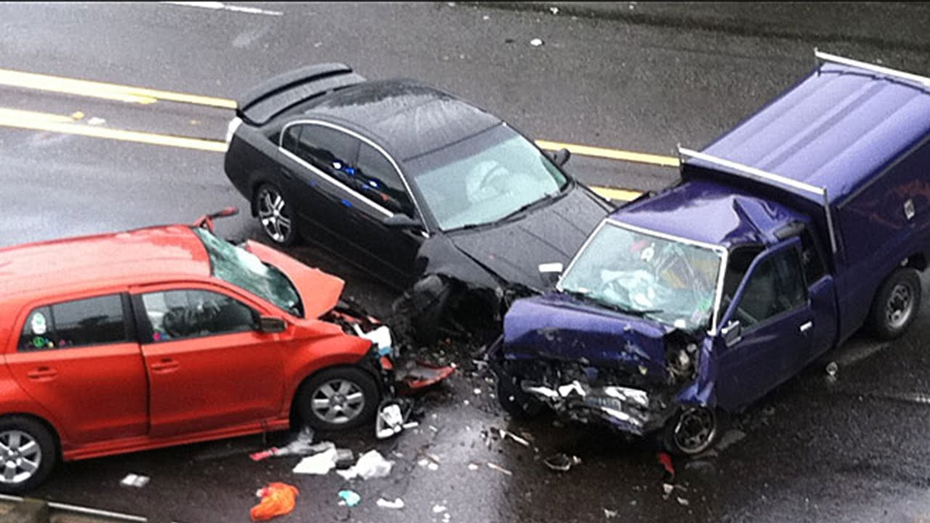
Exception Real Time Example
Using Exception Avoid Crashing
Without using exception Crashing
Avoiding a Car Crash
Let’s take this example of a Tesla crash. The software within the car was able to detect a stopped vehicle. The software was designed to recognize this as a known problem, or as an exception to normal behavior. The car was not able to completely prevent the crash. But, the developers were able to execute special logic to slow the car down to at least minimum the effect of the problem. Exception handling logic is key to good software. As developers, we have to anticipate the types of errors that may occur and handle them properly.

